Slide 1

Unveiling the Dark Reality
Crime Patterns in India
By Sridhar Kadhiri
Date : 17th July,2023

Slide 2
Unveiling the Dark Reality
Crime Patterns in India
By Sridhar Kadhiri
Date : 17th July,2023
Audience :
Welcome police officers, government officials and Stakeholders to the presentation on crime rates in India.
This presentation is specifically designed for police officers and government officials responsible for public safety and policymaking.
By gaining a comprehensive understanding of crime rates, you can enhance decision-making and devise strategies for effective crime prevention and control.
Purpose :
To provide an overview of crime rates in India and emphasize the importance of understanding them for effective law enforcement and policy-making.

Slide 3
Crime Analysis in India
Analysis
Types of Cognizable Crimes:
Population Analysis
Trends in Crime
Crime Rate
Charges Sheeting Rate
Crimes against Children
Crimes against Women
Murder Crimes
Victims of Murder
Kidnapping Cases
Violent Crimes

Slide 4
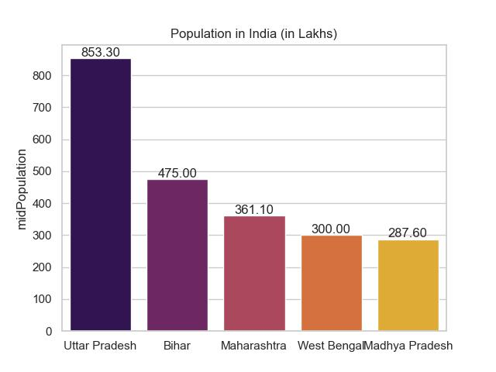
Indian States with Highest Population
Uttar Pradesh has the highest Population among the listed states, followed by Bihar, Maharashtra, West Bengal, and Madhya Pradesh.
The population measure is significant in analyzing crime rates in India because it allows for the contextualization and normalization of crime data based on the size of the population.

Slide 5
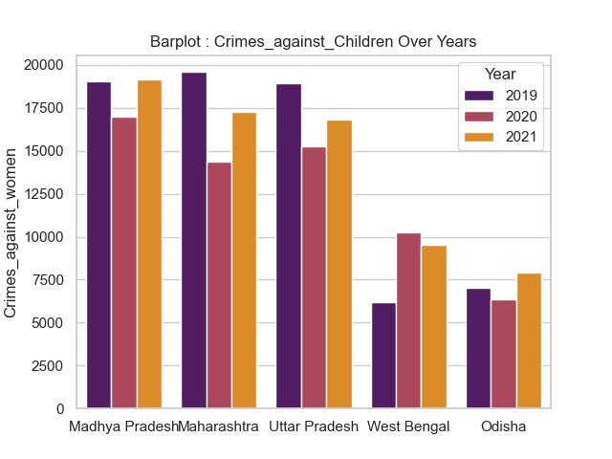
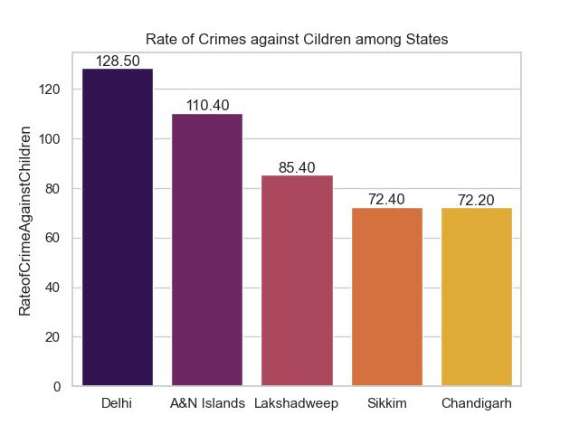
Crimes against Children
Trend over years
Rate of Crimes
Charges Sheeting rate
Among the given states in India, Madhya Pradesh had the highest number of reported crimes against Children in 2021, followed by Maharashtra and Uttar Pradesh, while West Bengal and Odisha had relatively lower numbers of reported crimes in the same year.
Delhi stands out with the highest rate of reported crimes against children, indicating a higher prevalence of such incidents in the region.
This insight highlights the need for focused efforts and interventions to address and prevent crimes against children, particularly in areas with higher rates.

Slide 6
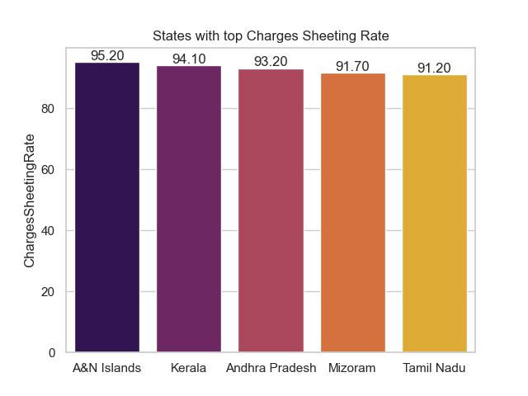
Crimes against Children
Trend over years
Rate of Crimes
Charges Sheeting rate
Delhi stands out with the highest rate of reported crimes against children, indicating a higher prevalence of such incidents in the region.
This insight highlights the need for focused efforts and interventions to address and prevent crimes against children, particularly in areas with higher rates.
Among the given states in India, Madhya Pradesh had the highest number of reported crimes against Children in 2021, followed by Maharashtra and Uttar Pradesh, while West Bengal and Odisha had relatively lower numbers of reported crimes in the same year.
In terms of charges sheeting rate for crimes against children, A&N Islands has the highest rate at 95.2%, followed by Kerala, Andhra Pradesh, Mizoram, and Tamil Nadu.

Slide 7
Crimes against Children
Trend over years
Rate of Crimes
Charges Sheeting rate
Delhi stands out with the highest rate of reported crimes against children, indicating a higher prevalence of such incidents in the region.
This insight highlights the need for focused efforts and interventions to address and prevent crimes against children, particularly in areas with higher rates.
In terms of charges sheeting rate for crimes against children, A&N Islands has the highest rate at 95.2%, followed by Kerala, Andhra Pradesh, Mizoram, and Tamil Nadu.

Slide 8
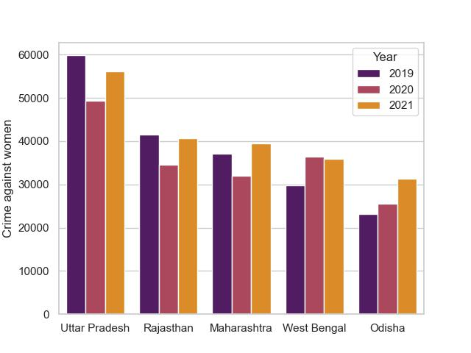
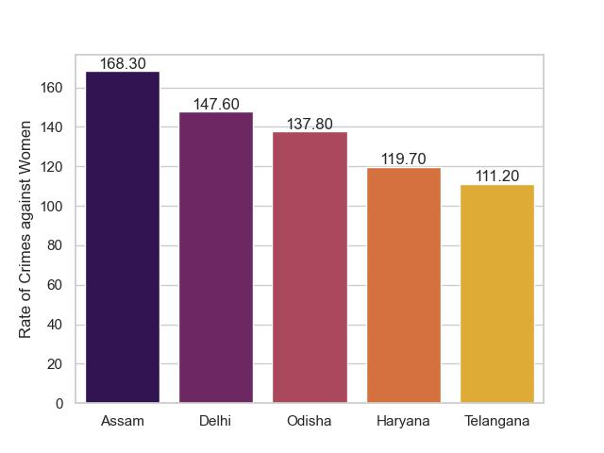
Crimes against Women
Trend over years
Rate of Crimes
Charges Sheeting rate
Uttar Pradesh consistently reports the highest number of crimes against women, followed by Rajasthan, Maharashtra, West Bengal, and Odisha, based on the data from 2019 to 2021.
Assam has the highest rate of reported crimes against women with a rate of 168.3, followed by Delhi, Odisha, Haryana, and Telangana, which also have relatively high rates of crimes against women.

Slide 9

Crimes against Women
Trend over years
Rate of Crimes
Charges Sheeting rate
Uttar Pradesh consistently reports the highest number of crimes against women, followed by Rajasthan, Maharashtra, West Bengal, and Odisha, based on the data from 2019 to 2021.
Assam has the highest rate of reported crimes against women with a rate of 168.3, followed by Delhi, Odisha, Haryana, and Telangana, which also have relatively high rates of crimes against women.
The states of Sikkim, Puducherry, and A&N Islands exhibit high charges sheeting rates, indicating efficient legal processes in converting reported crimes into formal charges, while Mizoram and Kerala also demonstrate relatively strong charges sheeting rates.

Slide 10
Crimes against Women
Trend over years
Rate of Crimes
Charges Sheeting rate
Assam has the highest rate of reported crimes against women with a rate of 168.3, followed by Delhi, Odisha, Haryana, and Telangana, which also have relatively high rates of crimes against women.
The states of Sikkim, Puducherry, and A&N Islands exhibit high charges sheeting rates, indicating efficient legal processes in converting reported crimes into formal charges, while Mizoram and Kerala also demonstrate relatively strong charges sheeting rates.

Slide 11
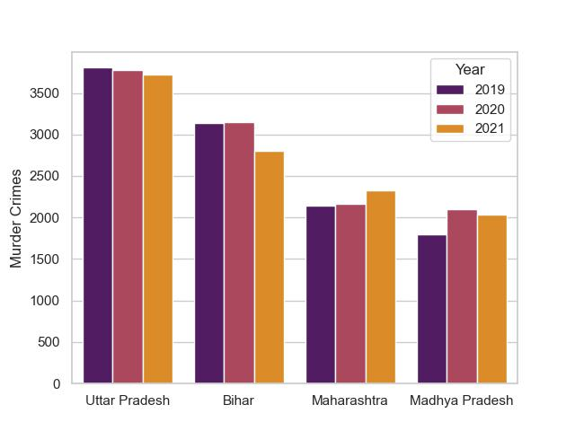
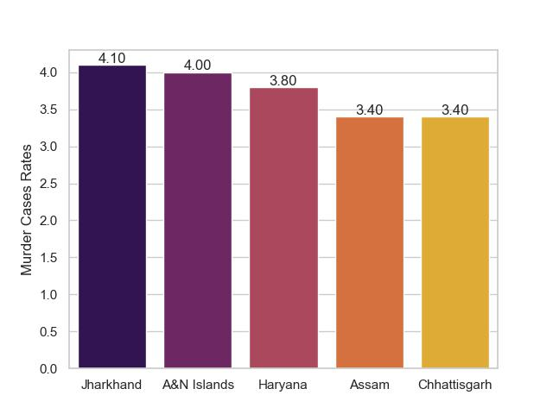
Murder cases in India
Trend over years
Rate of Crimes
Charges Sheeting rate
While there may be fluctuations, Uttar Pradesh consistently reports the highest number of reported crimes related to kidnapping and abduction among the listed states, followed by Bihar, Maharashtra, Madhya Pradesh, and West Bengal.
The states of Jharkhand, A&N Islands, Haryana, Assam, and Chattisgarh have relatively high rates of murder, indicating the prevalence of violent crimes in these regions, which may have adverse effects on public safety, well-being, and the overall perception of security within these states.

Slide 12

Murder cases in India
Trend over years
Rate of Crimes
Charges Sheeting rate
Ladakh and A&N Islands demonstrate a 100% charges sheeting rate, indicating a thorough and rigorous legal system or a higher occurrence of serious charges in these regions.
Ladakh and A&N Islands stand out with a 100% charges sheeting rate, indicating a need to explore the reasons behind this exceptional enforcement and assess the effectiveness of the legal system.
Puducherry, Tamil Nadu, and Delhi demonstrate relatively high charges sheeting rates, highlighting the importance of maintaining a robust legal framework and law enforcement measures.
While there may be fluctuations, Uttar Pradesh consistently reports the highest number of reported crimes related to kidnapping and abduction among the listed states, followed by Bihar, Maharashtra, Madhya Pradesh, and West Bengal.
The states of Jharkhand, A&N Islands, Haryana, Assam, and Chattisgarh have relatively high rates of murder, indicating the prevalence of violent crimes in these regions, which may have adverse effects on public safety, well-being, and the overall perception of security within these states.

Slide 13
Murder cases in India
Trend over years
Rate of Crimes
Charges Sheeting rate
Ladakh and A&N Islands demonstrate a 100% charges sheeting rate, indicating a thorough and rigorous legal system or a higher occurrence of serious charges in these regions.
Ladakh and A&N Islands stand out with a 100% charges sheeting rate, indicating a need to explore the reasons behind this exceptional enforcement and assess the effectiveness of the legal system.
Puducherry, Tamil Nadu, and Delhi demonstrate relatively high charges sheeting rates, highlighting the importance of maintaining a robust legal framework and law enforcement measures.
The states of Jharkhand, A&N Islands, Haryana, Assam, and Chattisgarh have relatively high rates of murder, indicating the prevalence of violent crimes in these regions, which may have adverse effects on public safety, well-being, and the overall perception of security within these states.

Slide 14
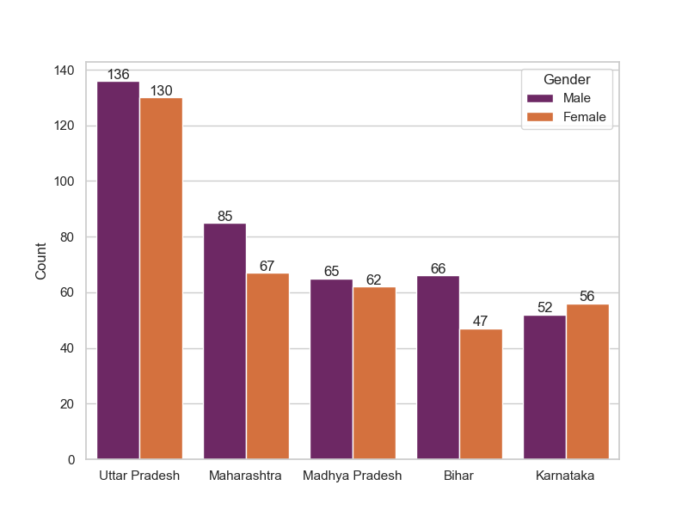
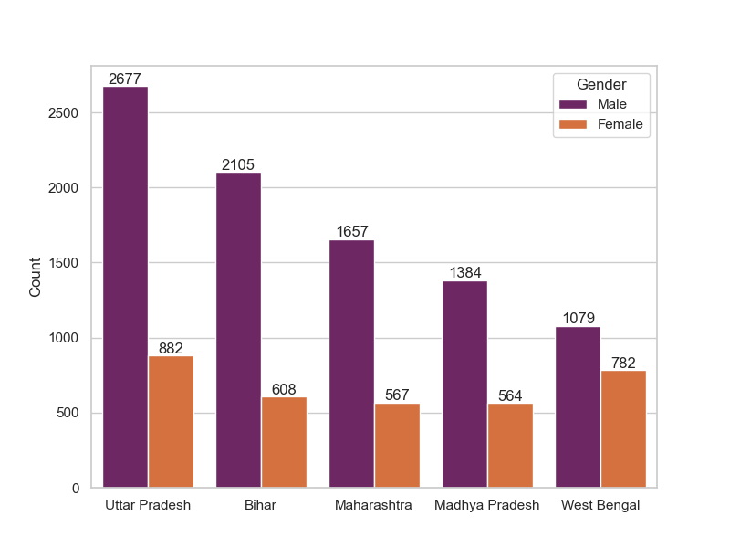
Victims of Murders
Children
Adults
In terms of the highest number of child murder victims, Uttar Pradesh stands out with a total count of 266 victims. It is notable that both males and females are equally affected, with 136 male victims and 130 female victims.
Maharashtra follows Uttar Pradesh with a significant count of 152 child murder victims. Again, both genders are affected, with 85 male victims and 67 female victims.
These insights highlight the unfortunate reality of child murder victims in these states, emphasizing the need for stronger efforts in child protection, law enforcement, and community awareness to prevent such tragic incidents.
Gender Disparity: Data from top cities reveals a concerning gender disparity in adult murder victims. Males overwhelmingly constitute the majority of victims in all cities, with Uttar Pradesh recording the highest number of male victims (2677), followed by Bihar (2105) and Maharashtra (1657). This highlights the need to explore the underlying factors contributing to the vulnerability of males in these areas.
Gender-based Violence: While the number of male victims is higher, it is crucial to acknowledge the presence of gender-based violence against females as well. The data shows that females are also victims of murder, with Uttar Pradesh (882) and Bihar (608) reporting relatively higher numbers.

Slide 15
Victims of Murders
Children
Adults
In terms of the highest number of child murder victims, Uttar Pradesh stands out with a total count of 266 victims. It is notable that both males and females are equally affected, with 136 male victims and 130 female victims.
Maharashtra follows Uttar Pradesh with a significant count of 152 child murder victims. Again, both genders are affected, with 85 male victims and 67 female victims.
These insights highlight the unfortunate reality of child murder victims in these states, emphasizing the need for stronger efforts in child protection, law enforcement, and community awareness to prevent such tragic incidents.
Gender Disparity: Data from top cities reveals a concerning gender disparity in adult murder victims. Males overwhelmingly constitute the majority of victims in all cities, with Uttar Pradesh recording the highest number of male victims (2677), followed by Bihar (2105) and Maharashtra (1657). This highlights the need to explore the underlying factors contributing to the vulnerability of males in these areas.
Gender-based Violence: While the number of male victims is higher, it is crucial to acknowledge the presence of gender-based violence against females as well. The data shows that females are also victims of murder, with Uttar Pradesh (882) and Bihar (608) reporting relatively higher numbers.

Slide 16
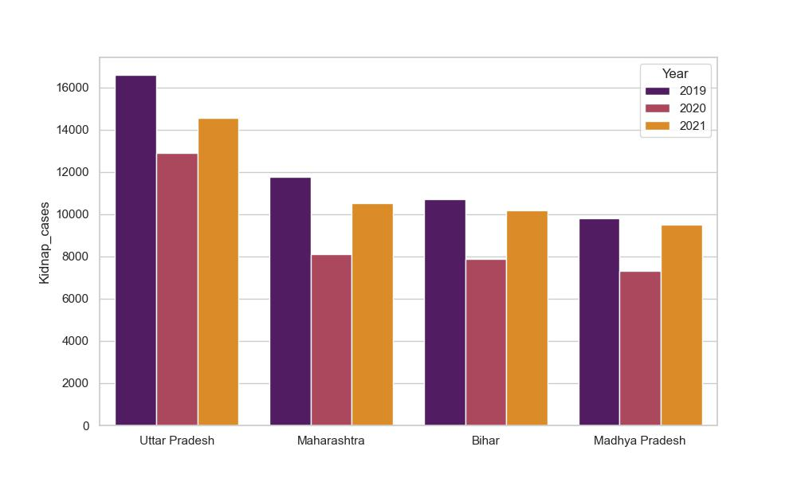
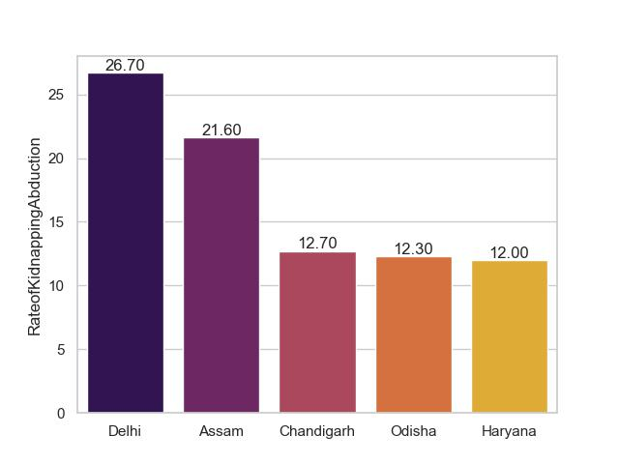
Kidnapping Cases
Trend over years
Rate of Crimes
Charges Sheeting rate
Kidnapping Hotspots: Uttar Pradesh consistently tops the list in recording the highest number of kidnapping crimes, with 14,554 cases reported in 2021, followed by Maharashtra (10,502) and Bihar (10,198). These states exhibit a significant prevalence of kidnapping incidents.
Rising Trend: Over the years, there has been a notable increase in kidnapping crimes in Maharashtra, with the number rising from 8,103 cases in 2020 to 10,502 cases in 2021. This upward trend requires focused attention and proactive measures to address the issue effectively.
Regional Variation: West Bengal experienced fluctuations in kidnapping cases, with a decrease from 9,309 cases in 2020 to 8,339 cases in 2021. However, the state still faces a substantial challenge in combatting kidnapping crimes, highlighting the need for sustained efforts in ensuring public safety.
Delhi has the highest rate of kidnapping and abduction cases in India, which highlights the concerning issue of personal safety and security in the capital city.
This calls for increased measures and resources to address and prevent such crimes, ensuring the well-being of individuals and maintaining public trust in the city's security system.

Slide 17
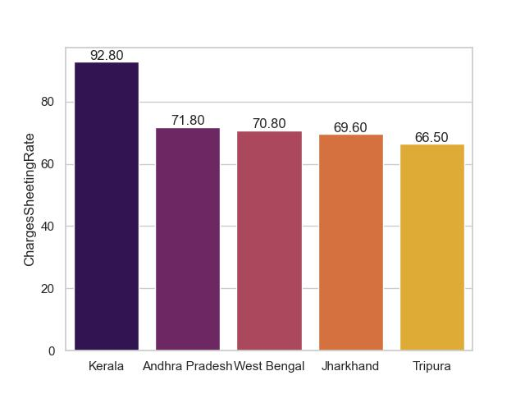
Kidnapping Cases
Trend over years
Rate of Crimes
Charges Sheeting rate
Kidnapping Hotspots: Uttar Pradesh consistently tops the list in recording the highest number of kidnapping crimes, with 14,554 cases reported in 2021, followed by Maharashtra (10,502) and Bihar (10,198). These states exhibit a significant prevalence of kidnapping incidents.
Rising Trend: Over the years, there has been a notable increase in kidnapping crimes in Maharashtra, with the number rising from 8,103 cases in 2020 to 10,502 cases in 2021. This upward trend requires focused attention and proactive measures to address the issue effectively.
Regional Variation: West Bengal experienced fluctuations in kidnapping cases, with a decrease from 9,309 cases in 2020 to 8,339 cases in 2021. However, the state still faces a substantial challenge in combatting kidnapping crimes, highlighting the need for sustained efforts in ensuring public safety.
The state of Kerala has the highest charges sheeting rate for kidnapping cases in India, followed by Andhra Pradesh, West Bengal, Jharkhand, and Tripura. This insight highlights the effectiveness of the legal system and law enforcement in Kerala, which may contribute to a higher rate of successful prosecution and conviction of kidnapping offenders.
It also suggests that the lower charges sheeting rates in other states may indicate potential challenges in the investigation and prosecution processes, potentially impacting the deterrence and justice outcomes for kidnapping cases in those regions.
Delhi has the highest rate of kidnapping and abduction cases in India, which highlights the concerning issue of personal safety and security in the capital city.
This calls for increased measures and resources to address and prevent such crimes, ensuring the well-being of individuals and maintaining public trust in the city's security system.

Slide 18
Kidnapping Cases
Trend over years
Rate of Crimes
Charges Sheeting rate
The state of Kerala has the highest charges sheeting rate for kidnapping cases in India, followed by Andhra Pradesh, West Bengal, Jharkhand, and Tripura. This insight highlights the effectiveness of the legal system and law enforcement in Kerala, which may contribute to a higher rate of successful prosecution and conviction of kidnapping offenders.
It also suggests that the lower charges sheeting rates in other states may indicate potential challenges in the investigation and prosecution processes, potentially impacting the deterrence and justice outcomes for kidnapping cases in those regions.
Delhi has the highest rate of kidnapping and abduction cases in India, which highlights the concerning issue of personal safety and security in the capital city.
This calls for increased measures and resources to address and prevent such crimes, ensuring the well-being of individuals and maintaining public trust in the city's security system.

Slide 19
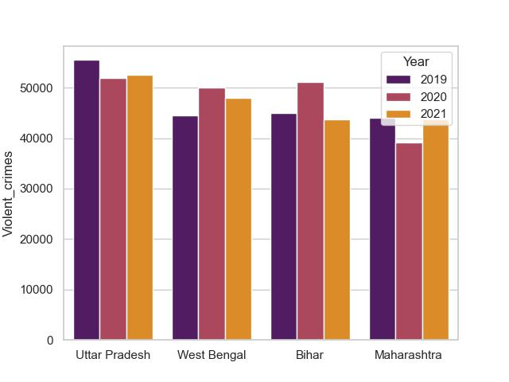
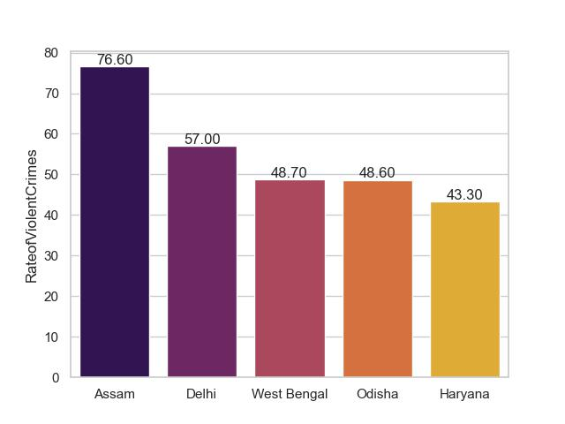
Violent Crimes
Trend over years
Rate of Crimes
Charges Sheeting rate
Persistent Leadership: Uttar Pradesh consistently ranks as one of the top states in terms of violent crimes. In 2021, it reported 52,502 cases, slightly higher than the previous year (51,983) and 2019 (55,519).
West Bengal: Steady violent crimes with around 47,900 cases in 2021, showing consistency compared to previous years (2020: 50,000; 2019: 44,600). Addressing root causes of violence is crucial.
Bihar: Witnessed fluctuations in violent crime numbers, with 43,800 cases in 2021, down from 51,100 cases in 2020. Understanding underlying factors is vital for effective crime prevention strategies.
Assam has the highest rate of violent crimes in India, followed by Delhi, West Bengal, Odisha, and Haryana.
This suggests that Assam has a relatively higher prevalence of violent crimes compared to other states, which may have negative implications for public safety, social well-being, and overall quality of life in the region.

Slide 20

Violent Crimes
Trend over years
Rate of Crimes
Charges Sheeting rate
Persistent Leadership: Uttar Pradesh consistently ranks as one of the top states in terms of violent crimes. In 2021, it reported 52,502 cases, slightly higher than the previous year (51,983) and 2019 (55,519).
West Bengal: Steady violent crimes with around 47,900 cases in 2021, showing consistency compared to previous years (2020: 50,000; 2019: 44,600). Addressing root causes of violence is crucial.
Bihar: Witnessed fluctuations in violent crime numbers, with 43,800 cases in 2021, down from 51,100 cases in 2020. Understanding underlying factors is vital for effective crime prevention strategies.
Assam has the highest rate of violent crimes in India, followed by Delhi, West Bengal, Odisha, and Haryana.
This suggests that Assam has a relatively higher prevalence of violent crimes compared to other states, which may have negative implications for public safety, social well-being, and overall quality of life in the region.
The data suggests that West Bengal has the highest charges sheeting rate for violent crimes among the listed states, followed by A&N Islands, Kerala, Andhra Pradesh, and Tamil Nadu.
This insight highlights the relatively efficient legal process in West Bengal in converting reported violent crimes into formal charges.

Slide 21
Violent Crimes
Trend over years
Rate of Crimes
Charges Sheeting rate
Assam has the highest rate of violent crimes in India, followed by Delhi, West Bengal, Odisha, and Haryana.
This suggests that Assam has a relatively higher prevalence of violent crimes compared to other states, which may have negative implications for public safety, social well-being, and overall quality of life in the region.
The data suggests that West Bengal has the highest charges sheeting rate for violent crimes among the listed states, followed by A&N Islands, Kerala, Andhra Pradesh, and Tamil Nadu.
This insight highlights the relatively efficient legal process in West Bengal in converting reported violent crimes into formal charges.

Slide 22
Conclusion
Improving legal processes: Learn from states like A&N Islands, Kerala, West Bengal, Andhra Pradesh, and Tamil Nadu to enhance investigation and prosecution procedures for better conversion of reported crimes into charges.
Urgent attention needed in high-crime states: Uttar Pradesh, Bihar, West Bengal, Maharashtra, and Madhya Pradesh require immediate action to address consistently high crime rates, including crimes against children, women, and kidnappings.
Focus on Assam and Delhi: Take comprehensive measures involving law enforcement, communities, and social programs to tackle the high rates of violent crimes and crimes against women in Assam and Delhi.
Collaboration is key: Foster collaboration among police officers, government officials, and stakeholders to develop and implement effective strategies, share best practices, and allocate resources for safer communities.
Continuous evaluation and adaptation: Regularly monitor data, identify emerging trends, and adjust policies to stay ahead of criminals and maintain public safety.
Assam has the highest rate of violent crimes in India, followed by Delhi, West Bengal, Odisha, and Haryana.
This suggests that Assam has a relatively higher prevalence of violent crimes compared to other states, which may have negative implications for public safety, social well-being, and overall quality of life in the region.
T
H
A
N
K
Y
O
U

Slide 23
Conclusion
T
H
A
N
K
Y
O
U

